Slide 1
Abstract Class and Interface

Slide 2
Agenda
Introduction
Abstract Classes
Abstract Class Example
Extending an Abstract Class
Interfaces

Slide 3
Abstract
Abstraction is a process of hiding the implementation details and showing only functionality to the user.
Way to achieve abstraction
Abstract classes
Interfaces

Slide 4
Facts
An abstract class is a class which cannot be instantiated
It not necessary that abstract class must have abstract method.
You can’t create objects to abstract class even though it does not contain any abstract methods.
Any class extends abstract class must have override all abstract Method.
NO Private method in abstract class.
Field cannot be abstract.
Abstract method CANNOT be static.

Slide 5
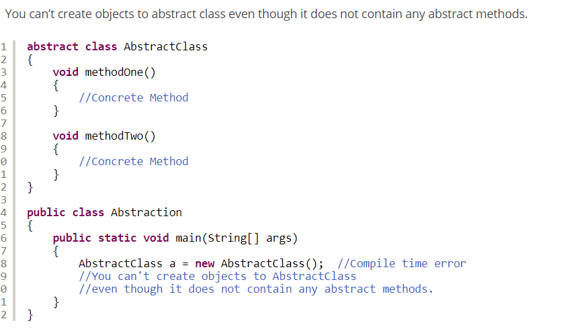
Can’t Create Object

Slide 6
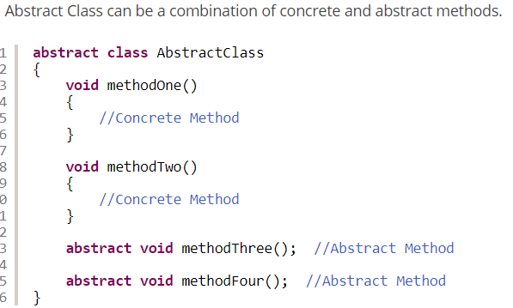
Concrete and Abstract methods

Slide 7
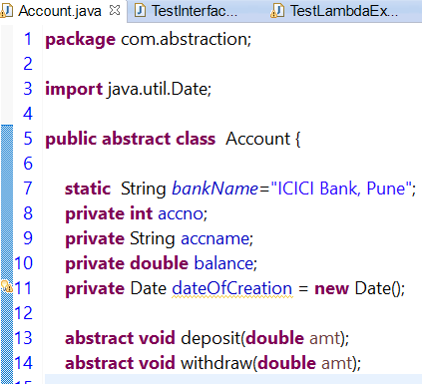
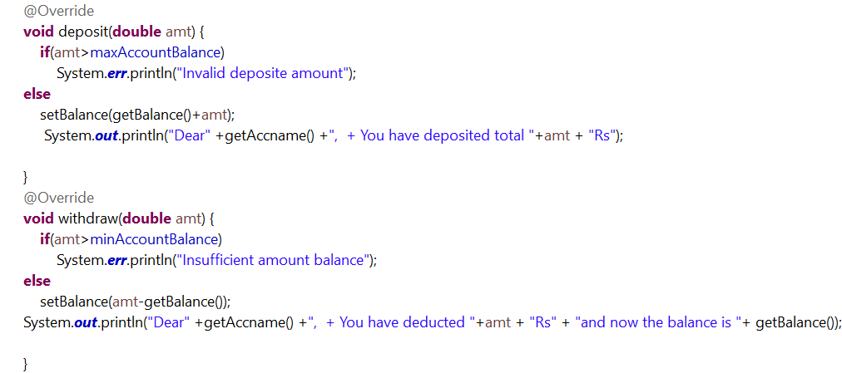
Abstract Classes and Methods

Slide 8
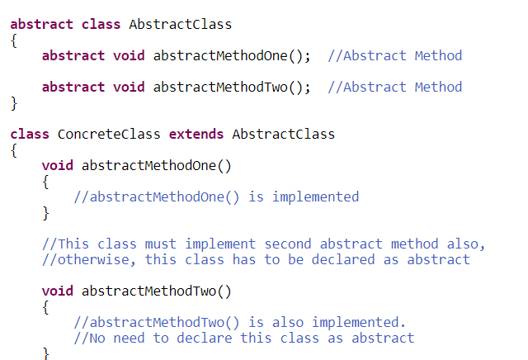
Must implement all abstract methods

Slide 9
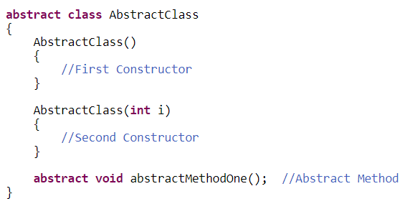
Can have number of constructor but NOT PRIVATE

Slide 10
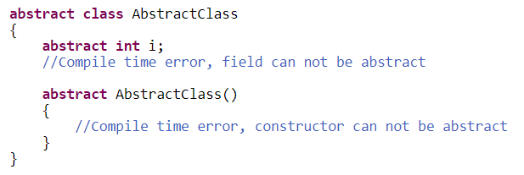
Fields and Constructor Cannot be abstract

Slide 11
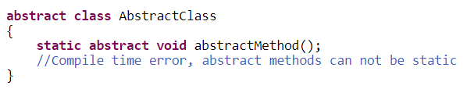
Cannot be static

Slide 12
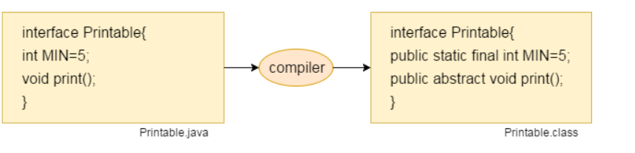
Interface
Generates . Class file.

Slide 13
Advantages of Interfaces
The benefits interface offers is it allows multiple inheritance which is not possible with concrete classes and abstract classes.
With interfaces, implements keyword is to be used instead of general extends keyword. Implements informs the compiler that what ever classes are there after implements, they are interfaces.
An interface gives template structure of methods from which new classes can be developed easily.
The same abstract methods of the interface can be overridden with different functionalities by different subclasses.

Slide 14
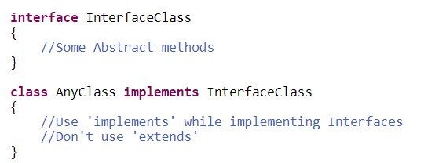
Implements

Slide 15
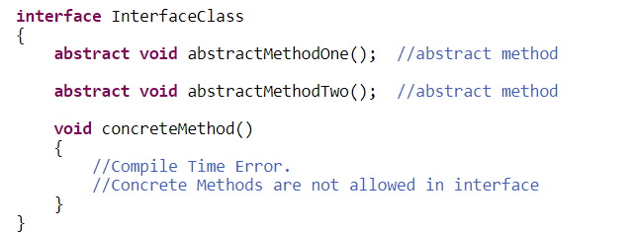
No Concrete Method

Slide 16
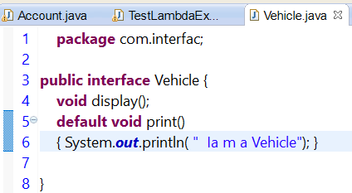
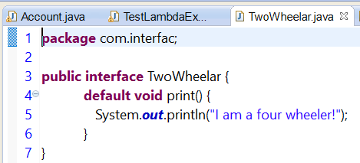
Implementation

Slide 17
Default Method in Interface
When to use: When concert class fail to use.
When to use this over abstract
Abstract Default Interface
Have constructor No Constructor
State associated with them. No reference to particular implementation state.

Slide 18
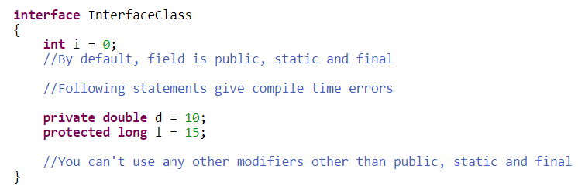
Members of Interfaces public static final
Fields are called as Constants.
Methods are public and abstract

Slide 19
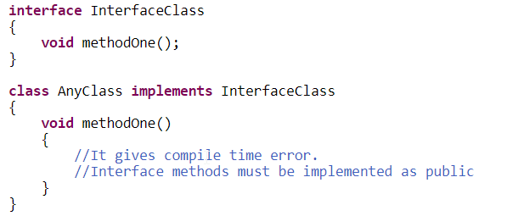
Method Overriding – Cannot reduce visibility

Slide 20
Marker Interface
java.lang.Cloneable Interface
java.util.EventListener
java.rmi.Remote
java.io.Serializable Interface :

Slide 21
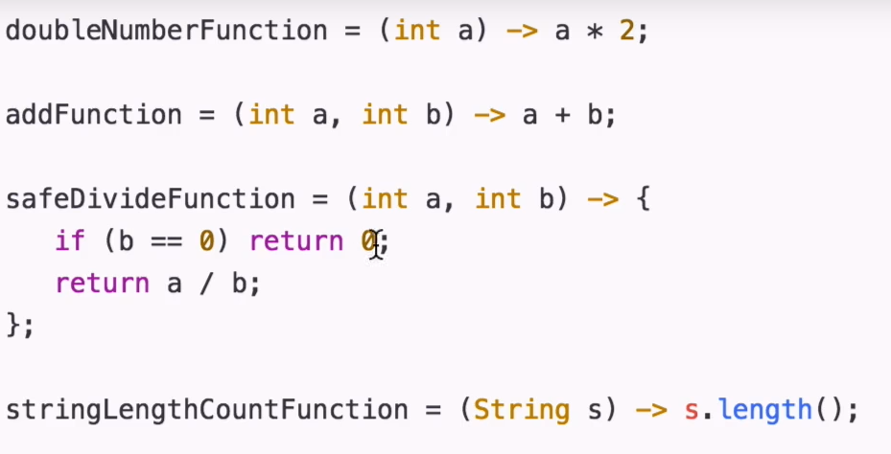
Lambda Expression

Slide 22
Lambda Expression - Functional Interface
We don't need to define the method again for providing the implementation.
Lambda expression provides implementation of functional interface. An interface which has only one abstract method is called functional interface.

Slide 23
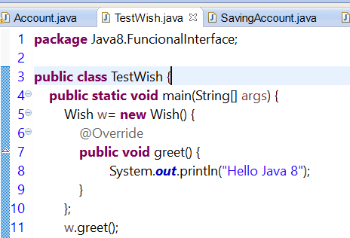
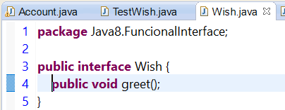
Functional Interface Without Lambda

Slide 24
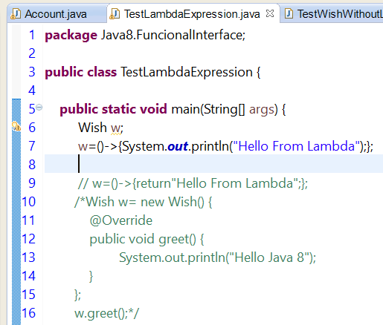
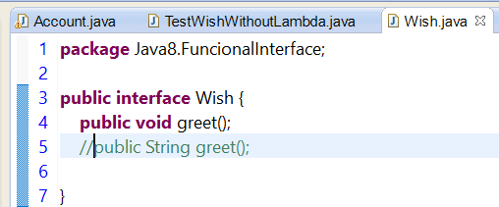

Functional Interface – With Lambda
Enforces Functional Interface – Now you cannot add one more method

Slide 25
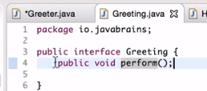
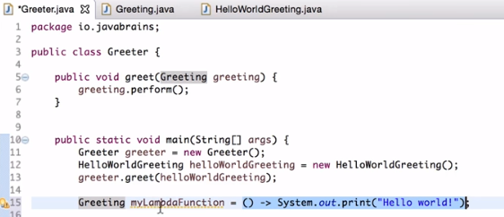
Why Lambda?
Less Code
Multiple lambda expression can match with single interface.
Implementation of Functional interface.

Slide 26
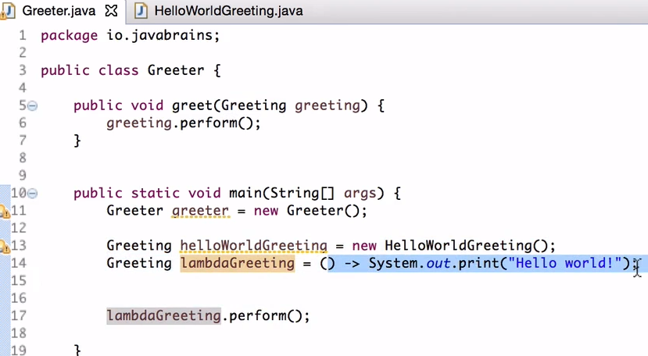
Lambda
Interface
We don’t create a class which is implementing an interface.
We need to create a class for implementation.

Slide 27
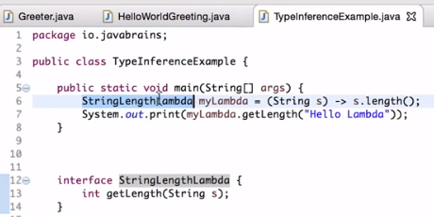
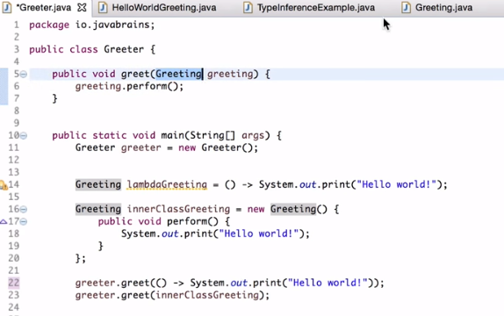
Lambda TypeInference
Shortcut

Slide 28
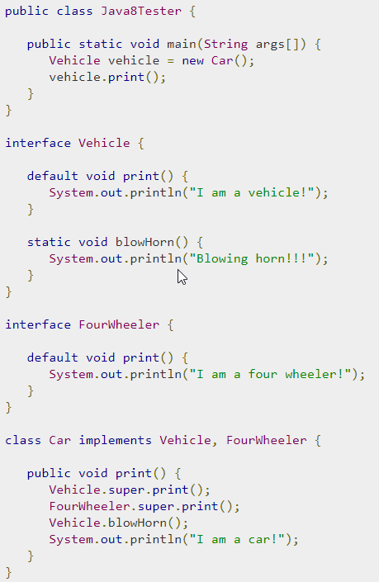
SIB and IIB not allowed before 7 Static method in Java8

Slide 29
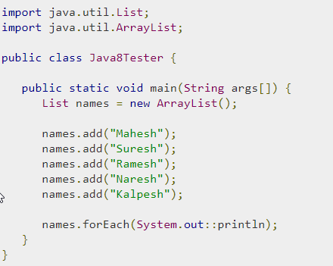
Method Reference – JAVA 8

Slide 30
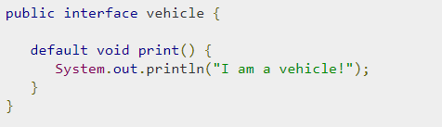
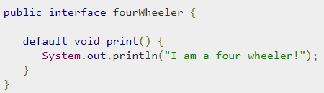
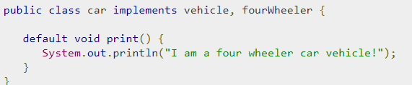
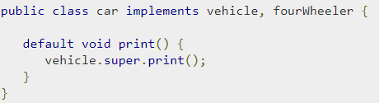
Interfaces in Java8
Multiple Default
Solution 1
(Override method)
Solution 2
Use Super keyword

Slide 31
QnA
Is it compulsory for a class which is declared as abstract to have at least one abstract method? – NO
Can we use “abstract” keyword with constructor, Instance Initialization Block and Static Initialization Block? – NO
Why final and abstract can not be used at a time?
Can we declare abstract methods as private? Justify your answer?
Abstract classes can be nested. True or false?
Can a class contain an abstract class as a member?
Can we re-assign a value to a field of interfaces?
Can we declare an Interface with “abstract” keyword?
Can we override an interface method with visibility other than public?
Can interfaces have static methods

Slide 32
QnA
Is it compulsory for a class which is declared as abstract to have at least one abstract method? – NO
Can we use “abstract” keyword with constructor, Instance Initialization Block and Static Initialization Block? – NO
Why final and abstract can not be used at a time?
Can we declare abstract methods as private? Justify your answer?
Abstract classes can be nested. True or false? –YES
Can a class contain an abstract class as a member? – Yes
Can we re-assign a value to a field of interfaces?- No
Can we declare an Interface with “abstract” keyword?
Can we override an interface method with visibility other than public?- NO
Can interfaces have static methods – NO

